Slide 1
CS46x: Senior Software Engineering Project
A Web-Based Tool for Task-Delineated, AI-Assisted Assignments
Group 28:
Oliver Zhou, Ethan Lu, Trent Matsumura, Sai Anand, Collin Kimball

Slide 2
Introduction
This project is a website that acts as a more extensively featured Learning Management System, similar to Canvas.
Key Features:
Task-delineation: Meaning divided tasks which enables complex structures for delivering assignments and tasks to students, allowing “stories.”
AI-integration: Implements AI tools to help instructors develop class content and evaluate student performance, and help students use AI to improve their thought processes.

Slide 3
The Problem
Organization:
Assignments are limited in their ability to represent complex structures in standard Learning Management Systems i.e. Canvas.
AI:
Students are encouraged or incentivized to use AI tools to quickly finish assignments, which isn’t productive for improving mental fitness
Punishing AI use does not stamp out the root of the problem, and misses the opportunity to use the technology for our advantage.

Slide 4
The Solution
We propose that we can a develop tool that better organizes assignments and allows them to be represented more comprehensively.
We also believe that we can use AI to benefit students’ learning and instructors to understand quickly how their students are doing.
More complex task organization and positive AI implementations will address the two issues in our problem statement.

Slide 5
Requirements
Our Project Mentor, Sanjai, has laid out the key requirements for this project, and we aim to complete them according to his guidance/desires.
Basic Overview:
Prototype a tool which functions similarly to Canvas, with these features:
Organized assignment structures
AI helper bots for students
AI report generation for instructors

Slide 6
Requirements (cont)
The scope of our requirements are flexible in scope, and our project mentor emphasized that things will change. We have already removed an old “collaborative” requirement.
Example functional requirements:
Configurable AI models
Dividable assignment tasks/stories
Exportable assignment objects
Report Generation
AI Bot Chat Window

Slide 7
Goals
Organizing assignments becomes easier for instructors, and students can more easily understand what is being assigned.
AI can be used to help students learn and exercise their mind, rather than use AI as a crutch.
AI helps instructors evaluate their students’ strengths and weaknesses.
Example Goals/Metrics:
Goal | Signal | Metric
Improve task organization for instructors and students | Users can easily create and track assignments with clear task delineation | Survey professors on a likert scale that has 80% or more neutral-positive responses.
Facilitate efficient tracking of student progress for instructors | Instructors can easily monitor task completion and student progress across assignments | 80% of instructors report on the survey that student progress tracking is easier or faster.

Slide 8
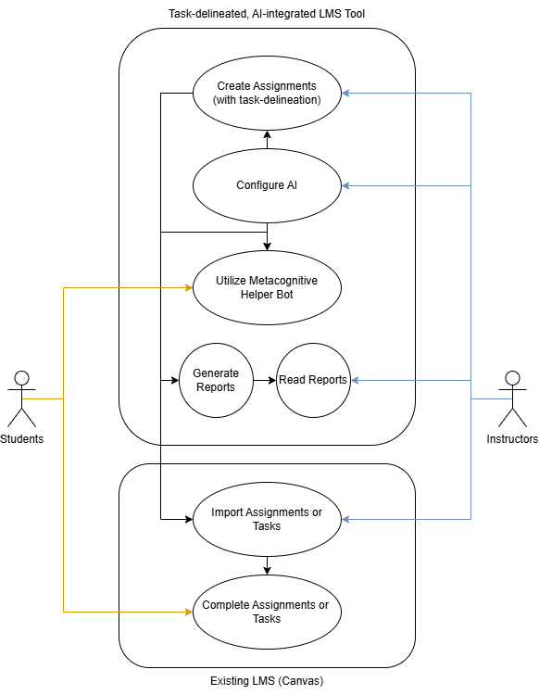
Use Cases
User | User Story | Criteria
University Instructor | As a university instructor, I want to designate when AI is appropriate and tailor chatbots to assist in those instances so that I can productively utilize AI in my classroom. | Instructors can enable or disable AI assistance for specific assignments or tasks within the tool.
Student | As a student, I want to be assisted through my learning journey, and receive help from an AI chatbot more productively, so that I can have a guided learning experience that improves my learning. | AI feedback and suggestions are actionable, allowing students to improve their work based on the guidance provided.

Slide 9
Design
The frontend and backend of this website will be built mostly traditionally, using HTML/CSS/JavaScript. For more complex web design, we also will use React/node.js.
For the scope of our project, we decided to use a pre-existing technology for our AI implementation. We will integrate this AI model with API requests for our AI features.

Slide 10
Components
Core Components:
Frontend
User Interface: Collects inputs and displays outputs
Backend
Handles internal logic of the web-page
Includes part of API processing for AI components
AI Components
Handles API requests with AI model

Slide 11
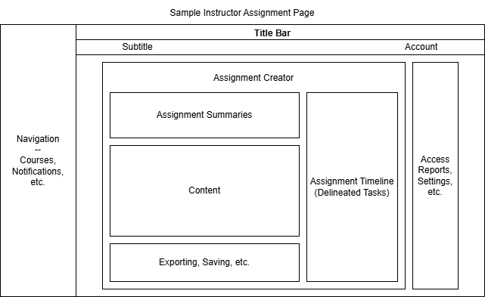
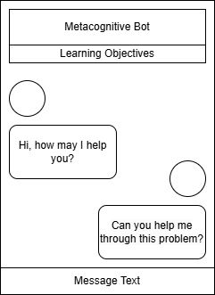
Mockups
Assignment Creation Page AI Helper Bot

Slide 12
Accessibility
Inclusive and Accessible design is crucial for our project because education should be for everyone, and we need to accommodate for people with disabilities or ESL.
Considerations in our design process:
Options for different reader stylings (i.e. font size, color)
Adhering to language guidelines and using understandable language
Basic language options for languages other than English

Slide 13
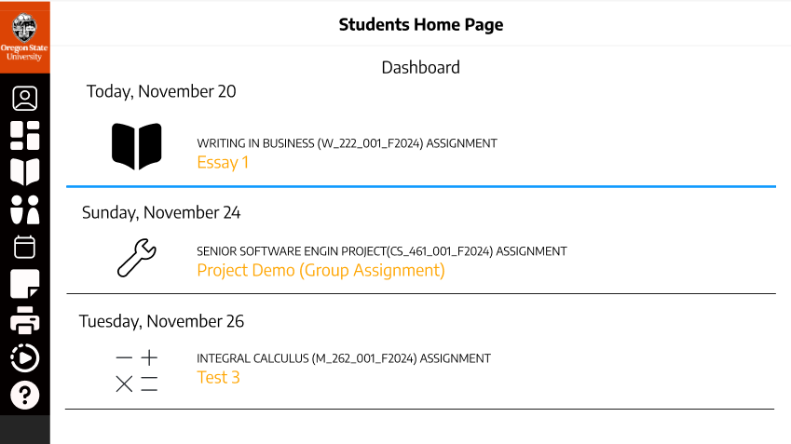
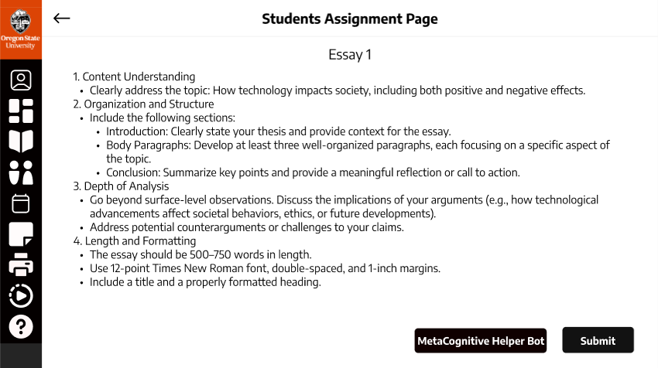
Mockups

Slide 14
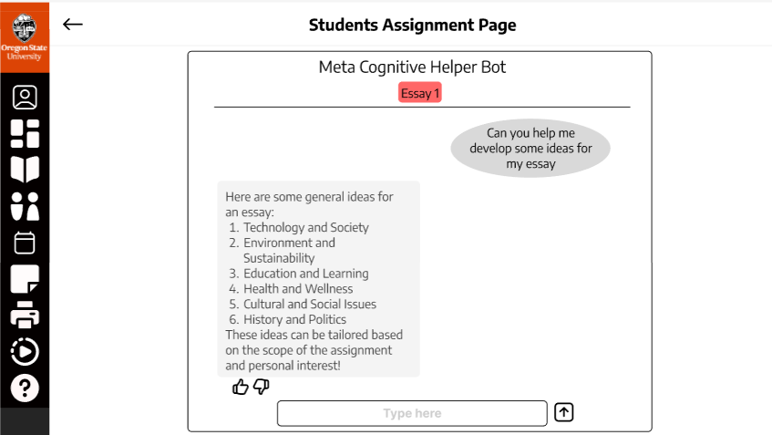
Mockups (cont)

Slide 15
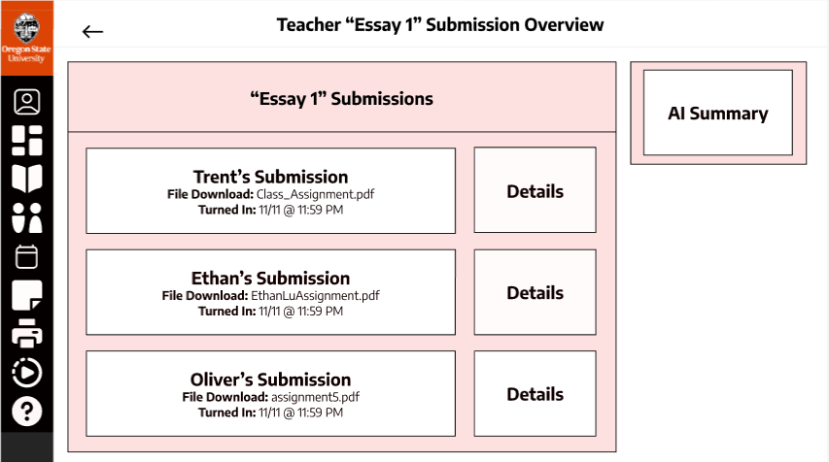
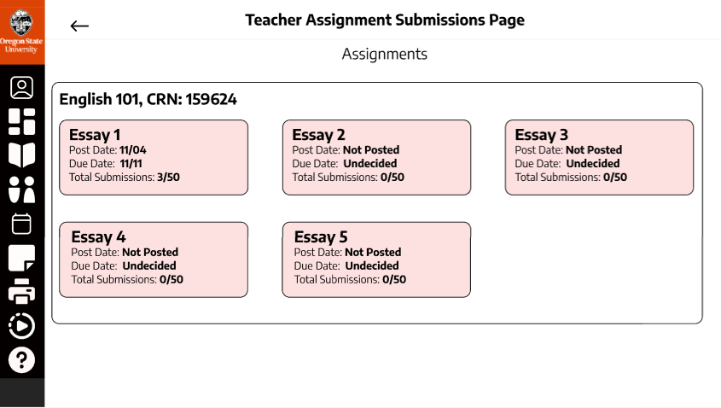
Mockups (cont)

Slide 16
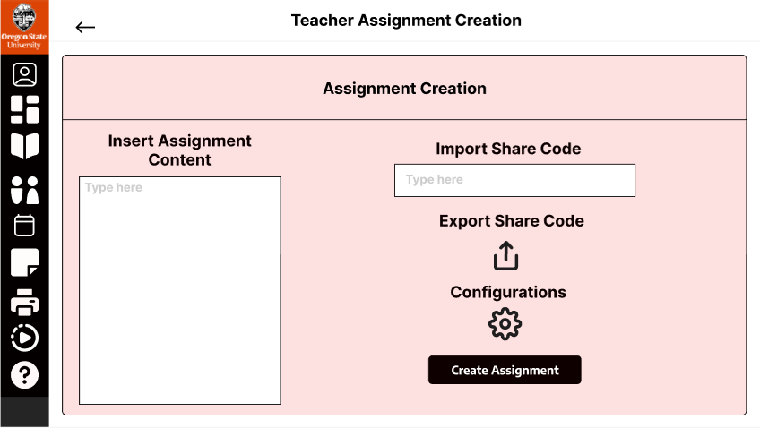
Mockups (cont)

Slide 17
Demo

Slide 18
Reflection
Communication
We are still getting used to working together as a team in a more formal project setting. We address communication issues by setting up our team charter comprehensively.
Deciding on Design and Conflicting Ideas
We overcame disagreements by referring to our project mentor for guidance, and doing activities/research to come to better decisions.

Slide 19
Conclusion
Feedback
We will continue to focus on implementing our project alongside our project mentor to make sure his concerns are addressed.
Results
Our demo currently has the basic framework and navigation finished. The core functionality for the requirements which address our issue are not completed. Functionality of these features will develop gradually in winter.
Where do we go from here?
Continue to implement features which meet assignment organization and AI requirements – both functional and non-functional.

Slide 20
Questions?

Slide 21
Thank You!

